Slide 1
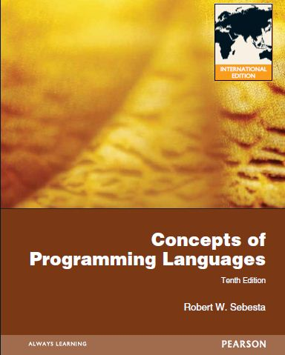
Subprograms

Slide 2
Chapter 9 Topics
Introduction
Fundamentals of Subprograms
Design Issues for Subprograms
Local Referencing Environments
Parameter-Passing Methods
Parameters That Are Subprogram Names
Overloaded Subprograms
Generic Subprograms
Design Issues for Functions
User-Defined Overloaded Operators
Coroutines
1-<number>

Slide 3
Properties of Subprograms
All subprograms have the following characteristics;
  Each subprogram has a single entry point.
  The calling program unit is suspended during the execution of the called subprogram, which implies that there is only one subprogram in execution at any given time.
  Control always returns to the caller when the subprogram execution terminates.
1-<number>

Slide 4
Subprogram Definitions
A subprogram definition describes
  the interface to
  and
  the actions of
the subprogram abstraction.
1-<number>

Slide 5
Subprogram Call
A subprogram call is the explicit request that the called subprogram be executed.
1-<number>

Slide 6
Active Subprogram
A subprogram is said to be active if, after having been called, it has begun execution but has not yet completed that execution.
1-<number>

Slide 7
Classes of Subprograms
The two fundamental kinds of subprograms,
  procedures
  and
  functions
1-<number>

Slide 8
Subprogram Headers
A subprogram header, which is the first part of the definition, serves several purposes.
  First, it specifies that the following syntactic unit is a subprogram definition of some particular kind.
    Some programming languages include two different kinds of subprograms; specifically, procedures and functions.
  Second, it provides a name for the subprogram.
  Third, it may optionally specify a list of parameters.
    They are optional because not all subprogram definitions have parameters.
1-<number>

Slide 9
Header Examples
The following is the header of a Fortran subprogram named Adder.
  Subroutine Adder(parameters)
In Ada, the header for Adder would be
  procedure Adder(parameters)
1-<number>

Slide 10
C Function Header
No special word appears in the subprogram header of a C subprogram.
C has only one kind of subprogram, functions (and/or methods).
For example,
  void adder(parameters)
  would serve as the header of a function named adder, where void indicates that it does not return a value.
1-<number>

Slide 11
The Parameter Profile and the Protocol of a Subprogram
The parameter profile (sometimes called the signature) of a subprogram is the
  number
  order
  and
  types
of its formal parameters.
The protocol of a subprogram is its parameter profile plus, if it is a function, its return type.
1-<number>

Slide 12
Subprogram Declarations
Subprogram declarations provide the subprogram’s protocol, but do not include their bodies.
  They are necessary in languages that do not allow forward references to subprograms.
1-<number>

Slide 13
Declaration and Type Checking
In both the cases of variables and subprograms, declarations are needed for static type checking.
  In the case of subprograms, it is the type of the parameters that must be checked.
1-<number>

Slide 14
Usage of Subprogram Declarations
In most other languages, subprograms do not need declarations, because there is no requirement that subprograms defined before they are called.
1-<number>

Slide 15
Approaches a Subprogram Could Use to Access Data
Subprograms typically describe computations.
There are two ways that a non-method subprogram can gain access to the data that it is to process:
  through direct access to nonlocal variables (declared elsewhere but visible in the subprogram)
  through parameter passing.
1-<number>

Slide 16
Data Passing through Parameters
Data passed through parameters are accessed through names that are local to the subprogram.
Parameter passing is more flexible than direct access to nonlocal variables.
1-<number>

Slide 17
Disadvantages of Data Access through Non-local Variables
If data access of a subprogram is through nonlocal variables, the only way the computation can proceed on different data is to assign new value to those nonlocal variables between calls to the subprogram.
Variables that are visible to the subprogram where access is desired often end up being visible where access to them is not needed
1-<number>

Slide 18
Using a Subprogram as a Parameter
In some situations, it is convenient to be able to transmit computations, rather than data, as parameters to subprograms.
In these cases, the name of the subprogram that implements that computation may be used as a parameter.
1-<number>

Slide 19
Formal Parameters
The parameters in the subprogram header are called formal parameters.
1-<number>

Slide 20
Actual Parameters
Subprogram call statements must include
  the name of the subprogram
  a list of parameters to be bound to the formal parameters of the subprogram.
    These parameters are called actual parameters.
    They must be distinguished from formal parameters because the two can have different restrictions on their forms, and of course their uses are quite different.
1-<number>

Slide 21
Advantages of Variable Number of Parameters
Although this design, which allows a variable number of parameters, is clearly prone to error, it is also sometimes convenient.
  For example, the printf function of C can print any number of items (data values and/or literal strings).
1-<number>

Slide 22
Disadvantages of Variable Number of Parameters – (1)
Format string attacks.
E.g.
foo()
{
  int i,j,k;
  printf(“%d %d”,i);
}
return address of foo()
caller ebp
local variable
:
local variable
parameters
return address of printf()
caller ebp
local variables
printf
don’t match
1-<number>

Slide 23
Disadvantages of Variable Number of Parameters – (2)
Format string attacks.
E.g.
foo()
{
  char StingInput[100];
  gets(StingInput);
  printf(StingInput,i);
}
return address of foo()
caller ebp
local variable
:
local variable
parameters
return address of printf()
caller ebp
local variables
Input: “%d %d %d %d\n”
1-<number>

Slide 24
Procedures and Functions
There are two distinct categories of subprograms:
  procedures
  and
  functions,
both of which can be viewed as approaches to extending the language.
1-<number>

Slide 25
Procedures and Statements
Procedures are collections of statements that define parameterized computations.
These computations are enacted by single call statements.
In effect, procedures define new statements.
  For example, because Ada does not have a sort statement, a user can build a procedure to sort arrays of data and use a call to that procedure in place of the unavailable sort statement.
In Ada, procedure are called just that; in Fortran, they are called subroutines.
1-<number>

Slide 26
Send back Results to the Calling Procedures
Procedures can produce results in the calling program unit by two methods.
  First, if there are variables that are not formal parameters but are still visible in both the procedure and the calling program unit, the procedure can change them.
  Second, if the subprogram has formal parameters that allow the transfer of data to the caller, those parameters can be changed.
1-<number>

Slide 27
Functions
Functions structurally resemble procedures but are semantically modeled on mathematical functions.
1-<number>

Slide 28
Function Invoking and Return Value
Functions are called by appearances of their names in expressions, along with the required actual parameters.
The value produced by a function's execution is returned to the calling code, effectively replacing the call itself.
  For example, the value of the expression f(x) is whatever value f produces when called with the parameter x.
1-<number>

Slide 29
Functions Define New User-defined Operators
For example, if a language does not have an exponentiation operator, a function can be written that returns the value of one of its parameters raised to the power of another parameter.
Its header in C++ could be
  float power (float base, float exp)
  which could be called with
  result = 3.4 * power(10.0, x)
1-<number>

Slide 30
Overloaded Subprograms and Generic Subprograms
An overloaded subprogram is one that has the same name as another subprogram in the same program.
A generic subprogram is one whose computation can be done on data of different types in different calls.
1-<number>

Slide 31
Semantics Models of Formal Parameters
Formal parameters are characterized by one of three distinct semantics models:
  they can receive data from the corresponding actual parameter
  they can transmit data to the actual parameter;
  they can do both.
These three semantics models are called
  in mode
  out mode
  inout mode
1-<number>

Slide 32
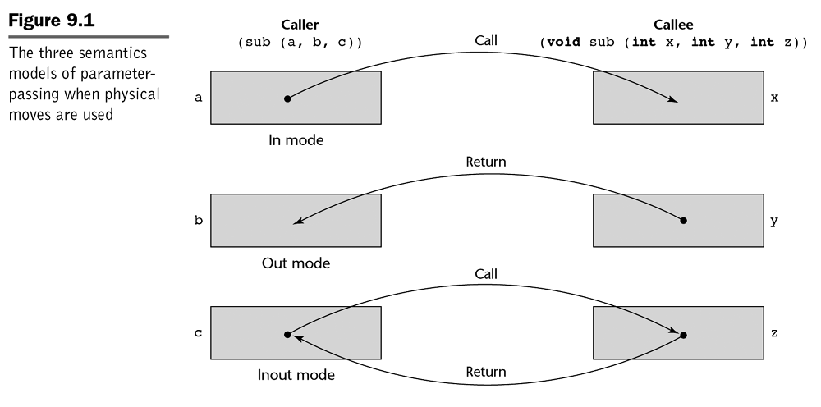
Figure
1-<number>

Slide 33
Conceptual Models of How Data Transfers Take Place
There are two conceptual models of how data transfers take place in parameter transmission;
  either an actual value is copied (to the caller, to the callee, or both ways)
  an access path is transmitted
    Most commonly, the access path is a simple
      pointer
      or
      reference.
1-<number>

Slide 34
Implementation Models of Parameter Passing
Pass-by-Value
Pass-by-Result
Pass-by-Value-Result
Pass-by-Reference
Pass-by-Name
1-<number>

Slide 35
Pass-by-Value
When a parameter is passed by value, the value of the actual parameter is used to initialize the corresponding formal parameter, which then acts as a local variable in the subprogram, thus implementing in-mode semantics.
1-<number>

Slide 36
Approaches to Implement Pass-by-Value
Pass-by-value is normally implemented by copy, because accesses are usually more efficient with this method.
It could be implemented by transmitting an access path to the value of the actual parameter in the caller, but that would require that the value be in a write-protected cell (one that can only be read).
1-<number>

Slide 37
Disadvantages of the Pass-by-Value Method
The main disadvantage of the pass-by-value method if copies are used is that additional storage is required for the formal parameter, either
  in the called subprogram
  in some area outside both the caller and the called subprogram
In addition, the actual parameter must be copied to the storage area for the corresponding formal parameter.
The storage and the copy operations can be costly if the parameter is large, such as an array with many elements.
1-<number>

Slide 38
Pass-by-Result
Pass-by-result is an implementation model for out-mode parameters.
When a parameter is passed by result, NO value is transmitted to the subprogram.
The corresponding formal parameter acts as a local variable, but just before control is transferred back to the caller, its value is transmitted back to the caller's actual parameter, which obviously must be a variable
1-<number>

Slide 39
Price of Different Implementations
If values are returned by copy, as they typically are, pass-by-result also requires the extra storage and the copy operations that are required by pass-by-value.
As with pass-by-value, the difficulty of implementing pass-by-result by transmitting an access path usually results in its being implemented by data copy.
1-<number>

Slide 40
Problem
One problem with the pass-by-result model is that there can be an actual parameter collision, as shown in the next slide.
1-<number>

Slide 41
Actual Parameter Collision Problem
actual parameters
call sub(p1,p1)
  In sub, assuming the two formal parameters have different names, the two can obviously be assigned different values.
  Because the order is sometimes implementation-dependent, for some languages, different implementations can produce different results.
1-<number>

Slide 42
Example – a C# Method
  void Fixer(out int x, out int y)
  {
  x = 17;
  y = 35;
  }
  ...
  f.Fixer(out a, out a);
If at the end of the execution of Fixer the formal parameter x is assigned to its corresponding actual parameter first, the value of the actual parameter a in the caller will be 35
If y is assigned first, the value of a in the caller will be 17.
1-<number>

Slide 43
Another Problem of Pass-by-Result
The implementer may be able to choose between two different times to evaluate the addresses of the actual parameters;
  at the time of the call
  or
  at the time of the return.
1-<number>

Slide 44
Pass-by-Value-Result
Pass-by-value-result is an implementation model for inout-mode parameters in which actual values are copied.
It is in effect a combination of pass-by-value and pass-by-result.
  The value of the actual parameter is used to initialize the corresponding formal parameter, which then acts as a local variable.
    In fact, pass-by-value-result formal parameters must have local storage associated with the called subprogram.
  At subprogram termination, the value of the formal parameter is transmitted back to the actual parameter.
1-<number>

Slide 45
Alias of Pass-by-Value-Result
Pass-by-value-result is sometimes called pass-by-copy because the actual parameter is copied to the formal parameter at subprogram entry and then copied back at subprogram termination.
1-<number>

Slide 46
Disadvantages and Problems of Pass-by-Value-Result
Pass-by-value-result shares with pass-by-value and pass-by-result the disadvantages of
  requiring multiple storage for parameters
  and
  time for copying values.
It shares with pass-by-result the problems associated with the order in which actual parameters are assigned.
1-<number>

Slide 47
Pass-by-Reference
Pass-by-reference is a second implementation model for inout-mode parameters.
Rather than copying data values back and forth, however, the pass-by-reference method transmits an access path, usually just an address, to the called subprogram.
This provides the access path to the cell storing the actual parameter. Thus the called subprogram is allowed to access the actual parameter in the calling program unit.
In effect, the actual parameter is shared with the called subprogram.
1-<number>

Slide 48
Advantages
The advantage of pass-by-reference is that the passing process itself is efficient, in terms of both time and space.
Duplicate space is not required, nor is any copying required.
1-<number>

Slide 49
Disadvantages – Indirect Addressing and Unnecessary Access
There are, however, several disadvantages to the pass-by-reference method.
  erroneous changes may be made to the actual parameter.
1-<number>

Slide 50
Disadvantages – Alias (1)
Another serious problem of pass-by-reference is that aliases can be created.
This should be expected because pass-by-reference makes access paths available to the called subprograms, thereby broadening their access to nonlocal variables.
1-<number>

Slide 51
Disadvantages – Alias (2)
The problem with these kinds of aliasing is :
  It is harmful to readability and thus to reliability.
  It also makes program verification extremely difficult.
1-<number>

Slide 52
Aliases – (1)
When parameters are passed by reference, collisions can occur between actual parameters.
Consider a C function procedure that has two parameters that are to be passed by reference, as in
  void fun(int *first, int *second)
If the call to fun happens to pass the same variable twice, as in
  fun(&total, &total)
then first and second in fun will be aliases.
1-<number>

Slide 53
Aliases – (2)
Collisions between array elements can also cause aliases.
For example:
  Suppose the function fun is called with two array elements that are specified with variable subscripts, as in fun(&list[i], &list[j]).
  If i is equal to j, then first and second are again aliases.
1-<number>

Slide 54
Aliases – (3)
Collisions between call-by-reference formal parameters and nonlocal variables that are visible.
For example, consider the following C code:
    int *global;
    void main()
    {
    ...
    sub(global);
    ...
    }
    void sub(int *param)
    {
    ...
    }
  Inside param and global are alias.
1-<number>

Slide 55
Pass-by-Name
When parameters are passed by name, the actual parameter is, in effect, textually substituted for the corresponding formal parameter in all its occurrences in the subprogram.
1-<number>

Slide 56
In general, the effect of pass-by-name is to textually substitute the argument expressions in a procedure call for the corresponding parameters in the body of the procedure, e.g., double(C[j]) is interpreted as C[j] := C[j] * 2.
1-<number>

Slide 57
Run-Time Stacks and Parameter Passing
In most languages, parameter communication takes place through the run-time stack.
The run-time stack is used extensively for subprogram control linkage (e.g. return address) and parameter passing.
1-<number>

Slide 58
Handling Pass-by-Value Parameters
Pass-by-value parameters have their values copied into stack locations.
The stack locations then serve as storage for the corresponding formal parameters.
C uses pass-by-value
  In C Pass-by-reference (inout mode) semantics is achieved by using pointers as parameters.
1-<number>

Slide 59
Handling Pass-by-Result Parameters
Pass-by-result parameters are implemented as the opposite of pass-by-value.
The values assigned to the pass-by-result actual parameters are placed in the stack, where they can be retrieved by the calling program unit upon termination of the called subprogram.
1-<number>

Slide 60
Handling Pass-by-Value-Result Parameters
Pass-by-value-result parameters can be implemented directly from their semantics as a combination of pass-by-value and pass-by-result.
The stack location for the parameters is initialized by the call and is then used like a local variable in the called subprogram.
1-<number>

Slide 61
Handling Pass-by-Reference Parameters
Pass-by-reference parameters are perhaps the simplest to implement.
Regardless of the type of the actual parameter, only its address must be placed in the stack.
1-<number>

Slide 62
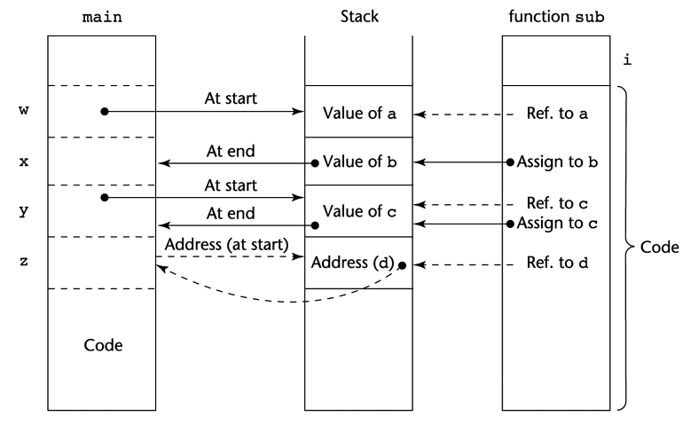

Figure 9.2 (1)
stack
code
1-<number>

Slide 63
Figure 9.2 (2)
sub is called from main with the call sub(w, x, y, z) ,
  w is passed by value
  x is passed by result
  y is passed by value-result
  z is passed by reference
Function header void sub (int a, int b, int c, int d)
1-<number>

Slide 64
A Skeletal C Program
void fun1(int x){
int y;
. . . <----------------------------------2
fun3(y);
. . .
}
void fun2(float r){
int s,t;
. . . <----------------------------------1
fun1(s);
. . .
}
void fun3(int q){
. . . <----------------------------------3
}
void main(){
float p;
. . .
fun2(p);
. . .
}
1-<number>

Slide 65
The Sequence of Procedure Calls
The sequence of procedure calls in the program in the previous slide is
  main calls fun2
  fun2 calls fun1
  fun1 calls fun3
1-<number>

Slide 66
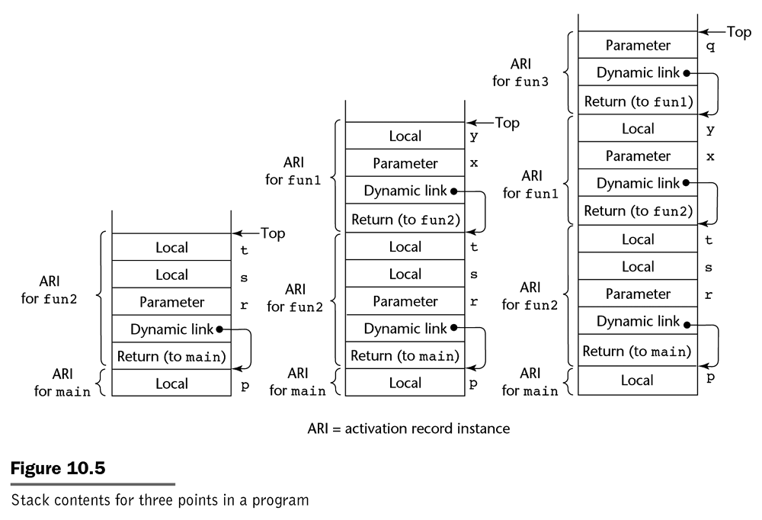
1-<number>

